Slide 1

GROUP -2 Presents
Financial Analysis Using AI of JPMorgan Chase & Bank of America
Ravi Teja Pancheddula
Vathsalya Kumar Doodhi
Nagaraju Bonagiri
Giridhar Kishore Kalluri
FNU Mohsin Khan Shaik

Slide 2


Background of JPMorgan Chase – Name
• JPMorgan Chase & Co. is one of the largest financial institutions in the world, founded in 2000 via the merger of several banking giants.
• Headquartered in New York City, it provides financial services worldwide across investment banking, consumer & community banking, commercial banking, and asset & wealth management.
• Product Lines: Credit cards, loans, checking/savings accounts, wealth management, investment banking.
• Industry Trends: Digitization, fintech disruption, rising interest rates, ESG regulations.
• Primary Competitor: Bank of America.
Presented by: Ravi Teja Pancheddula

Slide 3

ITEM | 2021 | 2022 | 2023
Total Revenue | 100% | 100% | 100%
Interest Income | 68% | 73% | 76%
Non- Ineterest Income | 32% | 27% | 24%
Operating Expenses | 58% | 59% | 58%
Net Income | 31% | 33% | 30.5%
Common Size Financial Statement
Presented by Ravi Teja

Slide 4

ITEM | 2021 | 2022 | 2023
Total Revenue | 100% | 100% | 100%
Interest Income | 62% | 67% | 70%
Non-Interest Income | 38% | 33% | 30%
Operating Expenses | 63% | 63% | 65%
Net Income | 26.6% | 26.6% | 17.9%
Common Size Financial Statement
Presented By Nagraj

Slide 5

Common-Size Comparison and Trends
• JPM consistently maintains a stronger profit margin than BofA across all years. • BofA’s net income declined sharply in 2023, suggesting margin compression. • JPM’s interest income is rising faster, likely due to stronger lending performance. • BofA’s higher expenses relative to revenue show operational inefficiencies. Presented by: [Your Name]
Presented By Bonagiri Giridhar

Slide 6

Ratio Analysis Table
RATIO | 2021(JPM/BofA) | 2022(JPM/BofA) | 2023(JPM/BofA) | B/W(Ranking)
Profit Margin | 31% / 26.6% | 33% / 26.6% | 30.5% / 17.9% | B/B/B
ROA | 1.37% / 0.70% | 0.34% / 0.86% | 1.37% / 0.79% | B/W/B
ROE | 17% / 10.3% | 14% / 9.8% | 21% / 9.79% | B/B/B
Debt to Asset | 92% / 96% | 91% / 95% | 91.6% / 94% | B/B/B
Current Ratio | 0.30x / 0.80x | 0.29x / 0.75x | 0.30x / 0.78x | W/W/W
Note : Inventory turnover not applicable for banks
Presented By Bonagiri Giridhar

Slide 7
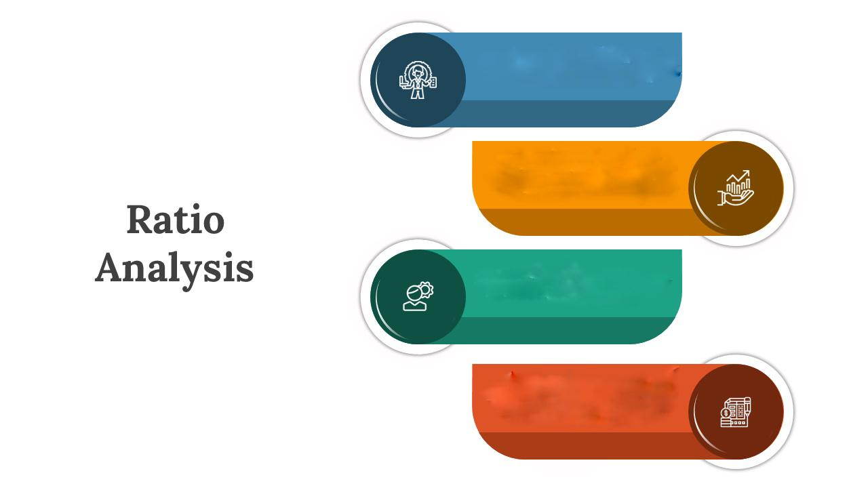
JPM outperforms BofA in profitability and return metrics in all years.
BofA has higher liquidity but at the cost of lower profitability.
JPM shows stronger control over operational costs
BofA is more vulnerable to interest margin compression.
Presented By FNU Mohsin Khan

Slide 8
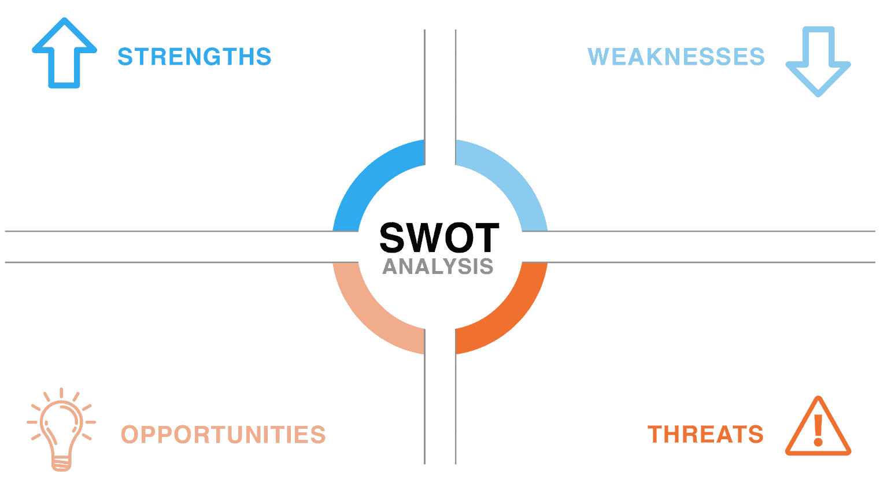
• Strong brand and global presence • Diversified income streams
• High regulatory exposure • Low current ratio
• AI/Fintech expansion • International growth
• Economic downturn • Cybersecurity risks
Presented By FNU Mohsin Khan

Slide 9

Recommendations
• Expand investment in fintech/AI to compete with digital banks. • Streamline operating expenses to improve margins further. • Explore sustainable finance options and ESG-backed portfolios. • Increase asset-liability matching to reduce interest rate risk.
Presented By Vathsalya

Slide 10
REFERENCES
• JPMorgan Chase 10-K 2023 – www.sec.gov • Bank of America 10-K 2023 – www.sec.gov • Macrotrends.net – JPM/BAC Ratios • OpenAI ChatGPT (AI financial analysis support) • Yahoo Finance – JPM/BAC historicals
Presented By Ravi Teja Pancheddula

